Slide 1
Analysing REF
Industrial team project (ITP) 2017
Team Members:
Eleanor Woodhead
Weijiang Lin (Gloria)
George Chrysostomou
Rawaida Kamarudin
Jagoda Karpowicz

Slide 2
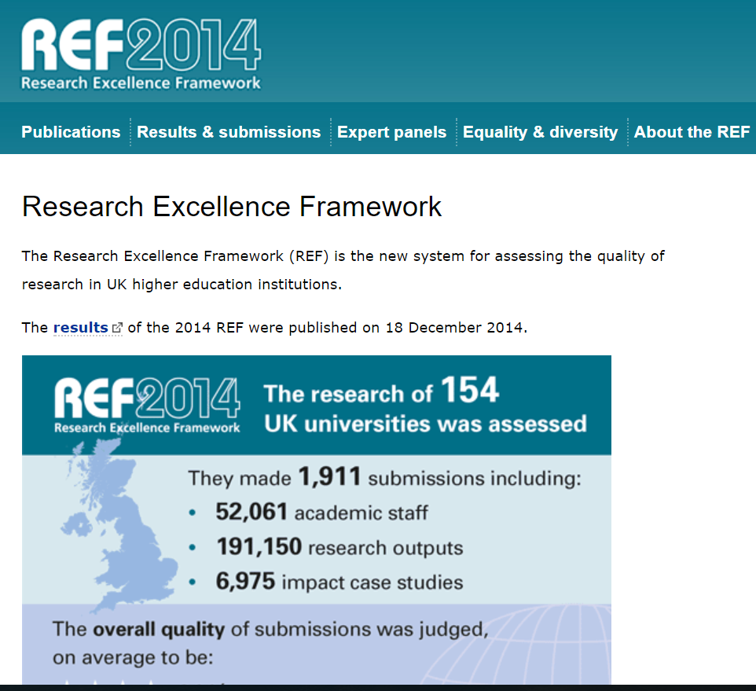
WHAT IS THE RESEARCH EXCELLENCE FRAMEWORK (REF)?
Formal system for assessing quality of research in UK
Primary purpose – determine proportion of public funding allocated to individual universities for research
Replace Research Assessment Exercises (RAE) (last conducted in 2008)
Conducted every 5 to 6 years
Notes:
Background

Slide 3
WHAT IS OUR GOAL for this PROJECT?
PROJECT AIM
Discover features from data that affect the outcome of REF
PROJECT RELEVANCE
Better understanding of factors that can increase the quality of publications
Attract more research funding
PROJECT VISION
Create a predictive model for REF results
Notes:
In the Why? Section:
Public funds for research are allocated based on the outcome of an REF
Understanding which factors affect the outcome of the REF can then help departments submit papers aimed at higher ratings

Slide 4
What is our approach?
Validation and Interpretation of Results
Validation and Interpretation of Results
Testing Hypotheses
Validation and Interpretation of Results
Testing Hypotheses
Defining Hypotheses
Testing Hypotheses
Defining Hypotheses
Preparing the Data
Defining Hypotheses
Preparing the Data
Understanding the task
Preparing the Data
Understanding the task
Notes:
Understanding the task:
Get a basic understanding of what is REF and RAE and their differences
Have a preliminary overview of the data to get a feel of what we have and don’t have available
Think of approaches to gathering the data
Map the process of paper submission to REF outcome to understand any possible dependence of different features
Preparing the data:
Extracting the data
Most data is available on very large excel files
Clean and normalise the data
Perform simple statistics to get an initial sense on what is going on
Defining Hypotheses:
Study literature to identify previous work on similar issue and also view different approaches to the problem
Define the hypotheses for our project
Testing of Hypotheses:
Identify first any factors that have a correlations between them
Identify any biases and discard any irrelevant information
Prepare data for testing
And test Hypotheses with the relevant factors
Validation and interpretation of results:
Check results with a testing data set that was not used to check the hypotheses
Comapre results with literature
Interpret Results and draw conclusions
Report writing
IF POSSIBLE WE WILL DO THE MODEL
First considerations are to build a model following a decision tree approach
Multinominal output

Slide 5
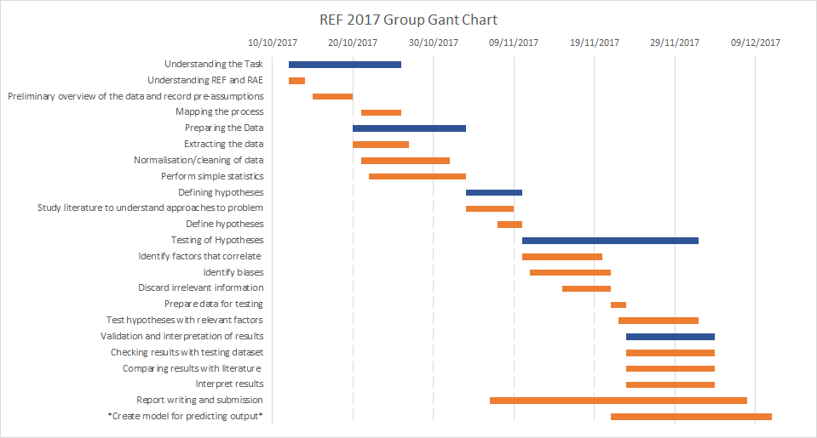
Notes:
Each team member will be accountable for 2 units of assessments (fields of interest) in REF

Slide 6
WHAT HAVE WE DONE THUS FAR?
**** I DON’T THINK WE NEED THIS SLIDE *****
Understood the differences between REF and RAE
Extracted the majority of the data from the REF website
Started cleaning and normalising the data
First thoughts on model building
Started reading literature
Notes:
Background

